Slide 1
Berbagai macam kabel
Suplemen materi 04 PTT

Slide 2
Two wire line
Figure 4.25 Geometry of a two-wire line and electric and magnetic field distribution of a TEM-wave.
https://www.oreilly.com/library/view/rf-and-microwave/9781118349571/c04_level1_8.xhtml

Slide 3
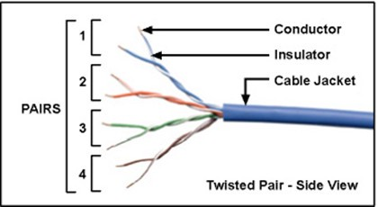
Twisted pair

Slide 4
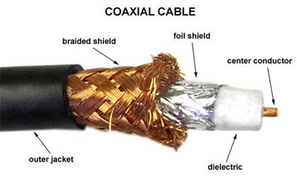
Koaksial

Slide 5
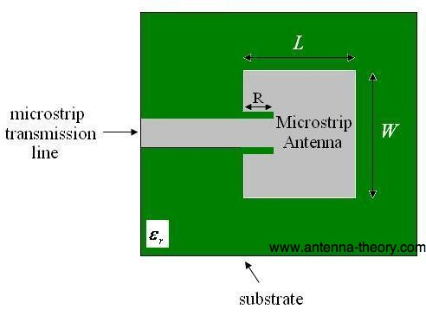
Mikrostrip

Slide 6
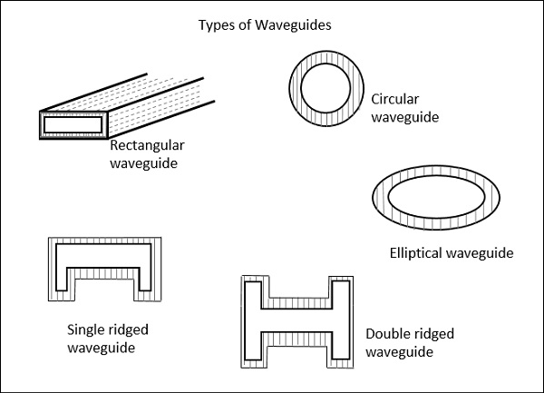
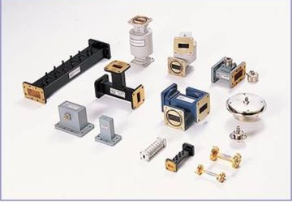
Waveguide

Slide 7
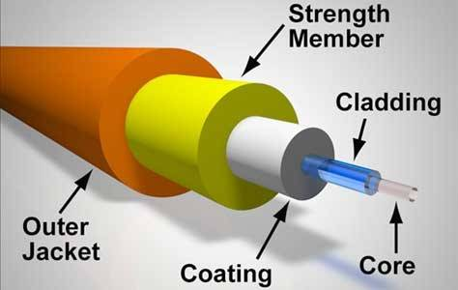
Serat Optik

