Slide 1
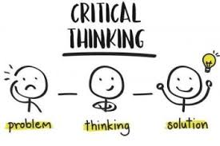
Critical Thingking for Engineering
Dr. Ir. ERNA SRI SUGESTI, M.Sc.
ernasugesti@telkomuniversity.ac.id
0812-2259-2001
School of Electrical Engineering
Telkom University

Slide 2
Critical Thinking Consists of Three Main Basic Abilities and Skills [Jessop 2002]:
Analysis
Synthesis
Evaluation
Analysis: solve the problem into parts and find relationships between them.
Synthesis: think of other ways to solve a problem either by entering new information or combining parts in different ways.
Evaluation: make valuations about results using available evidence.
School of Electrical Engineering

Slide 3
Think critically. Qiao (2009), "When a person uses the methods and principles of scientific thought in daily life, he practices critical thinking.
Find the Problem then define the problem/question
collect information and resources, and or (observe / observation)
create or (arrange) hypotheses and explanations
Test hypotheses by doing experiments or observations and collecting data in a way that can be reproduced
Data analysis
Interpreting data and make conclusions that serve as a starting point for new hypotheses
Publish results
Retest (frequently done by other scientists)
School of Electrical Engineering

Slide 4
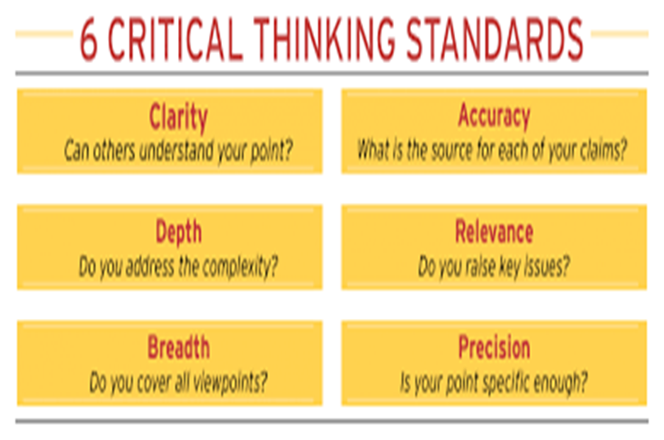
Critical thinking can be considered the same as the scientific method, but the main points are understanding the problem and defining the problem, finding solutions, evaluating, and iterating.
From the two previous views, it can be said :
Critical thinking must be according to standards
School of Electrical Engineering

Slide 5
Problems :
Watch this video and use Critical way of thinking to find problems and possible solutions that you can propose those problems
Discuss and make a note of the results from the point above
Emergency landing
Find for examples of other problems that can be raised as material for discussion about Critical Thinking
https://www.youtube.com/watch?v=R7dty6VCtJw
https://www.youtube.com/watch?v=6pS6IXku0uc
https://www.youtube.com/watch?v=E3MlRRM9tpA
https://www.youtube.com/watch?v=EKIRuBhoeQI
School of Electrical Engineering

Slide 6
Discussion :
School of Electrical Engineering

Slide 7
School of Electrical Engineering

