Slide 1
Informasi

Slide 2
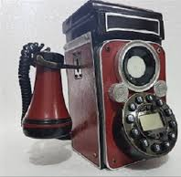
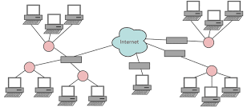
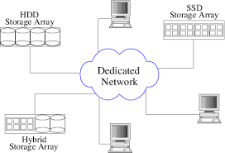
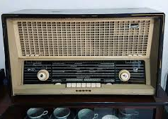
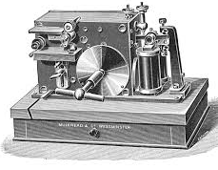
Diagram teknologi telekomunikasi
Introduction to telecommunications network engineering/Tarmo Anttalainen.—2nd ed. ARTECH HOUSE, INC.

Slide 4
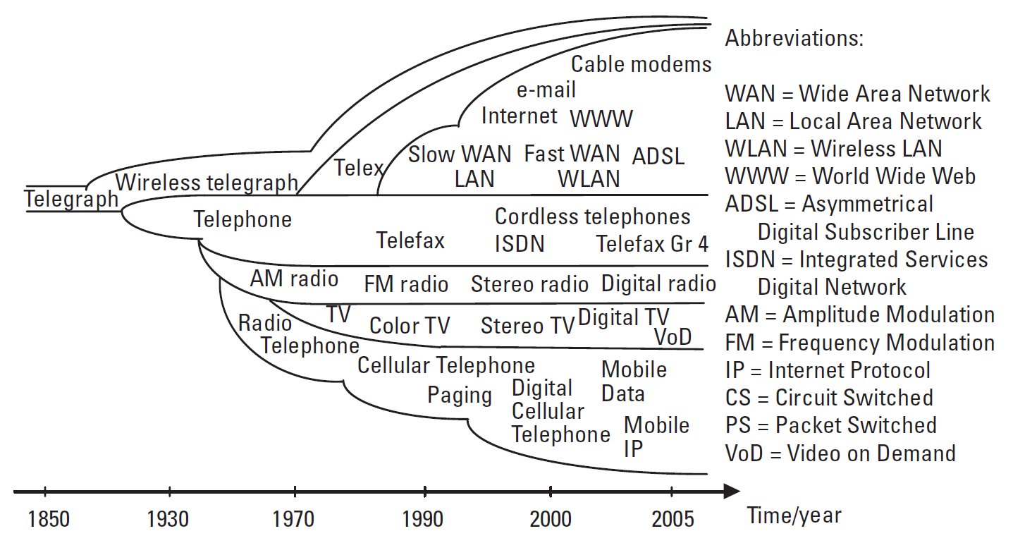
Perkembangan sistem telekomunikasi dan layanan
Introduction to telecommunications network engineering/Tarmo Anttalainen.—2nd ed. ARTECH HOUSE, INC.

