Slide 1
An integrated survey in Optical Networks: Concepts, Components and Problems
Delivered by
Erna Sri Sugesti, Ir., MSc.
1 May 2013
Ali Norouzi †, A.Halim Zaim ††, Berk Burak Ustundag, IJCSNS International Journal of Computer Science and Network Security, VOL.11 No.1, January 2011

Slide 2
1. introduction

Slide 3
Point-to-point link apparatus: Overview
Tx
Transmission medium
Rx
O
O
E
E
connectors
splices
Optical Sources:
LED
LASER
Optical fiber
Optical Detector:
p-i-n photodiode
Avalanche photodiode
(APD)
Types:
Single Mode
Step Index Multimode
Graded Index Multimode
Characteristics:
Optical output power
Wavelength
Linewidth
Characteristics:
Attenuation
Dispersion
Characteristics:
Responsitivity
Quantum Efficiency
Sensivity

Slide 4
Optical fiber system advantages:
Wider bandwidth
Low transmission loss
Dielectric waveguide
Small size and weight

Slide 5
Main parts of optical fiber networks:
Optical technologies
Components that provide routing and grooming
Restoration at wavelength level as well as wavelength-based services

Slide 6
2. Material and methods

Slide 7
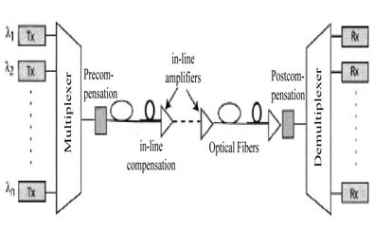
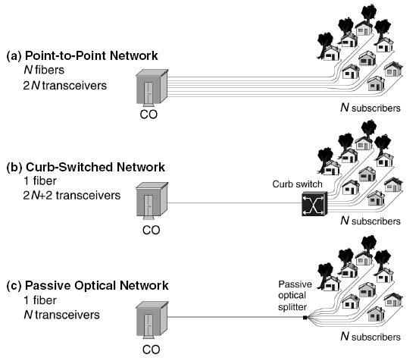
2. 1 Optical network properties
3 properties for next generation access networks:
Point-to-point topologies
Passive optical networks
Optical wireless technologies
Fig. 2 Structure of a point-to-point WDM transmission system.
Fig. 1 Different technologies for fiber-to-the-home (FTTH).

Slide 8
Cont’: Optical wireless technology
Tx
Free space medium
Rx
O
O
E
E
Optical networks development goal:
to move toward dynamic all-optical networks

Slide 9
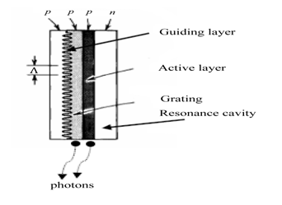
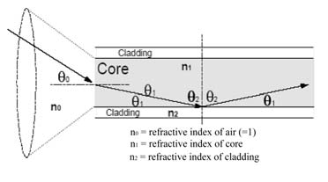
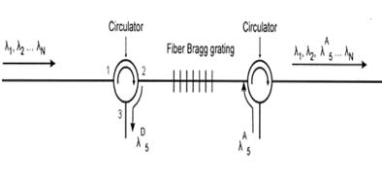
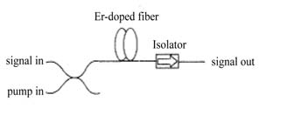
2.2 Optical network components
Transmitter: DFB, DBR
Multiplexer and Demultiplexer
Fiber Properties: SM
Optical Amplifiers: SOA, EDFA, EDWA
Optical Switches: WRS
Receivers: p-i-n, APD

Slide 10
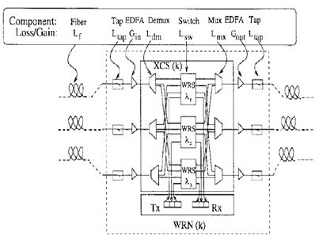
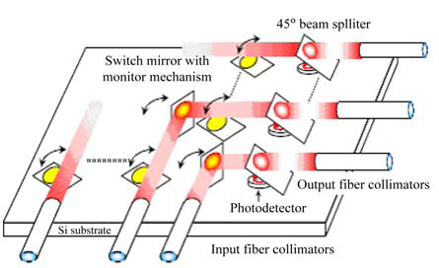
Fig. 8 The general structure of an optical switch
Fig. 9 Structure of a MEMS wavelength routing switch. Micromirrors are used to guide input beam to different outputs.

Slide 11
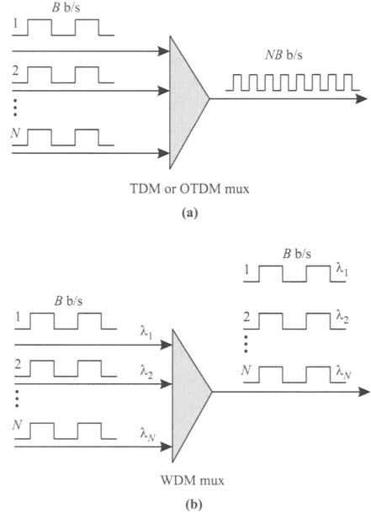
2.3 Multiplexing techniques
TDM
WDM, CWDM, DWDM

Slide 12
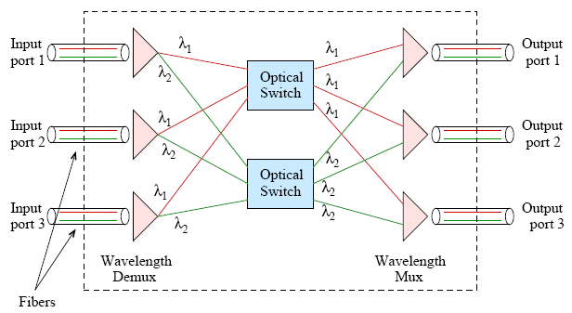
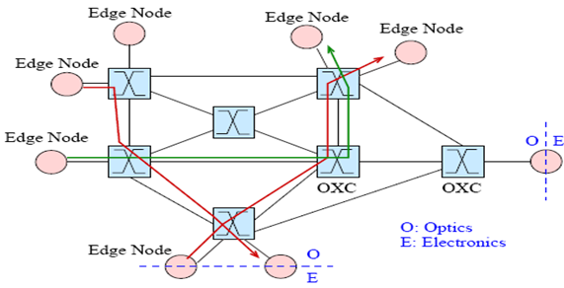
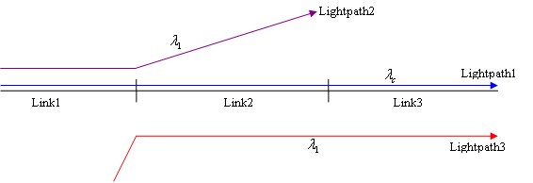
2.4 Optical WDM Networks
Network with optical fiber transmission links and architecture designed to exploit the unique features of fibers and WDM

Slide 13
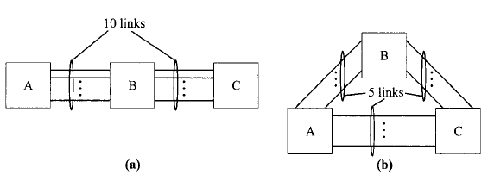
2.5 Problems of Designing Wavelength Routing
General problems:
Fiber (network) topology
Traffic requirements (traffic matrix)

Slide 14
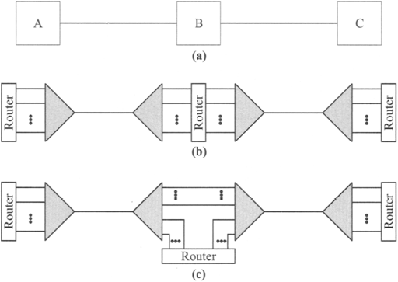
2.6 Network design and fiber topology problems
Light Topology Design (LTD)
Routing and Wavelength Assignment (RWA)
Wavelength continuity constraint
Distinct wavelength constraint

Slide 15
2.7 Grooming the higher-layer traffic
SDH (synchronous digital hierarchy)
SONET (synchronous optical network)

Slide 16
3. Results & discussion

Slide 17
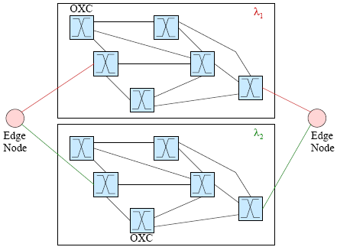
3.1 RWA Problems in Optical Networks
Finding a path and a free wavelength for a source destination pair

Slide 18
3.2 Classifying RWA based on Routing
Static routing algorithms
Adaptive routing algorithms
Dynamic routing algorithms

Slide 19
3.2.1 Static routing algorithms
Fixed Path Routing
Fixed Alternate Routing

Slide 20
3.2.2 Adaptive routing algorithms
Adaptive Routing
Traditional Adaptive RWA
Physically Aware Adaptive RWA

Slide 21
3.2.3 Dynamic routing algorithms
Connection requests are initiated randomly.
Steps:
Compute a number of candidate physical paths for each source-destination edge node pair and arrange the min a path list.
Order all wavelengths in a wavelength list.
Starting with the path and wavelength at the top of the corresponding list, search for a feasible path and wavelength for the requested lightpath.

Slide 22
3.3 Classifying RWA based on Propagation
Centralized architecture
Distributed architecture

Slide 23
3.4 Wavelength Assignment (WA) Problem
Constraints:
Distinct Channel Assignment (DCA)
Wavelength Continuity
WA-algorithm:
Random-fit
First-fit
Most-used

Slide 24
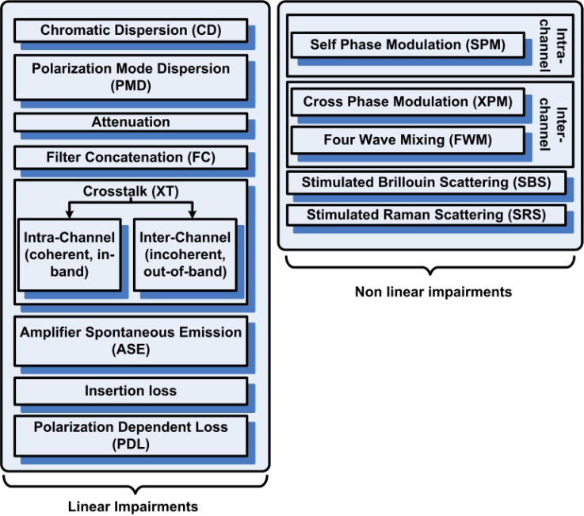
3.5 Physical Impairment
Linear effects
Nonlinear effects

Slide 25
3.6 Linear Impairment
Fiber attenuation
Components insertion loss
Amplifier spontaneous emission (ASE)
Chromatic dispersion (CD) or group velocity dispersion (GVD)
Polarization dispersion mode (PMD)
Polarization dependent losses (PDL)
Crosstalk (XT) (both inter- and intra-channel)
Filter concatenation (FC)

Slide 26
3.7 Non-Linear Impairments
Self Phase Modulation (SPM)
Cross Phase Modulation (XPM)
Four-wave Mixing (FWM)
Stimulated Brillouin Scattering (SBS)
Stimulated Raman Scattering (SRS)

Slide 27
3.8 Future works

