Slide 1
TELECOMMUNICATION NETWORK PERFORMANCE
The big picture

Slide 2
Lecture’s Scopes:
The big picture of current telecomm. networks
Qos metrics (1): phycisal layer and data link layer metrics
Qos metrics (2): network layer and transport layer metrics
System reliability (1): MTTF, MTTF, MTBT, FIT, availabilty, survivabilty
System reliabilty (2): surviability for optical and wireless network cases
Network queuing (1): concepts, Kendall notation
Network queuing (2): Markov chains model
Network controlling (1): optimations
Network controlling (2): optimations
Network modeling and simulation (1)
Network modeling and simulation (2)
Network case 1
Network case 2
Network case 3

Slide 3
Main References:
William C. Hardy, “QoS Measurement and Evaluation of Telecommunications Quality of Service,” John Wiley & Sons, 2001.
Dietmar Tutsch, Performance Analysis od network Architectures, Springer-Verlag Berlin Heidelberg, 2006
Wah Chun Chan, Performance Analysis of Telecommunications and Local Area Networks, Kluwer Academic Publishers, 2002.
Piet Van Mieghem, Performance Analysis of Communications Networks and Systems, Cambridge University Press, 2006.
Demetres D. Kouvatsos (Editor), Network Performance Engineering, Springer-Verlag Berlin Heidelberg, 2011
Jeremiah F. Hayes, Thimma V. J. Ganesh babu, Modelling and Analysis of Telecommunications Networks, John Wiley & Sons Inc, 2004

Slide 4
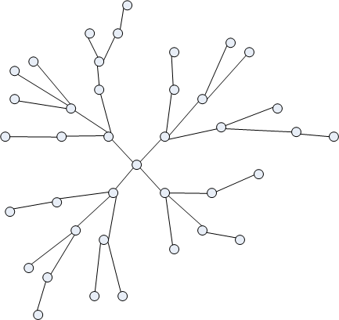
Telecomm Networks
A telecommunications network is a collection of terminal nodes, links and any intermediate which are connected so as to enable telecommunication between the terminals.
The transmission links connect the nodes together. The nodes use circuit switching, message switching or packet switching to pass the signal through the correct links and nodes to reach the correct destination terminal.
Each terminal in the network usually has a unique address so messages or connections can be routed to the correct recipients.
en.wikipedia.org

Slide 5
Telecommunication Nodes Examples
Fixed Telephones Network
Cellular communication
a public or private telephone exchange,
a remote concentrator,
a computer providing some intelligent network service.
Base station controller
Home Location Register
Gateways GPRS Support (GGSN)
Serving GPRS Support Node (SGSN,
.

Slide 6
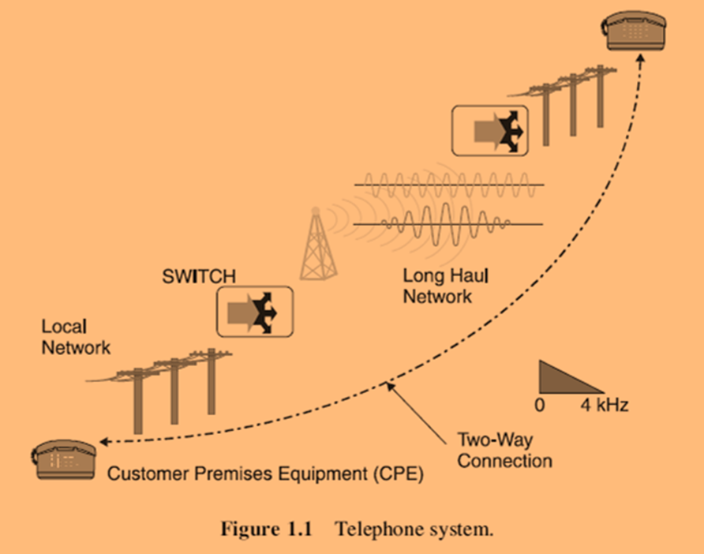
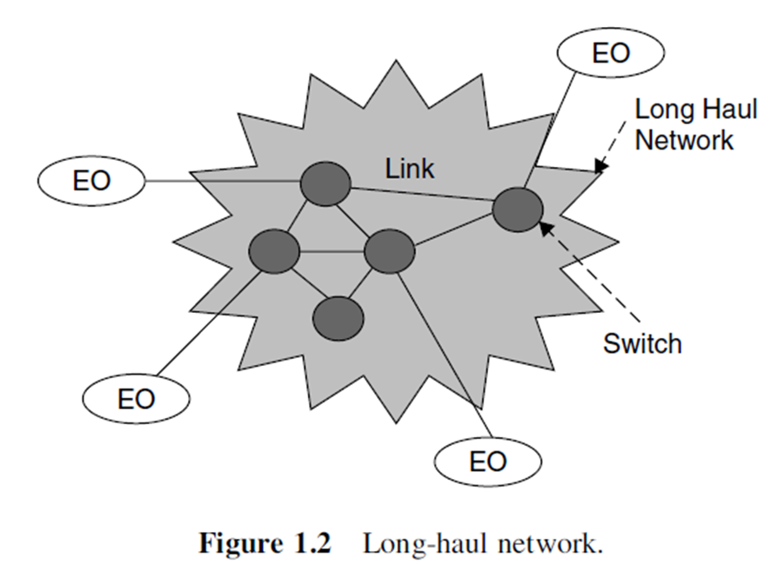

Slide 7
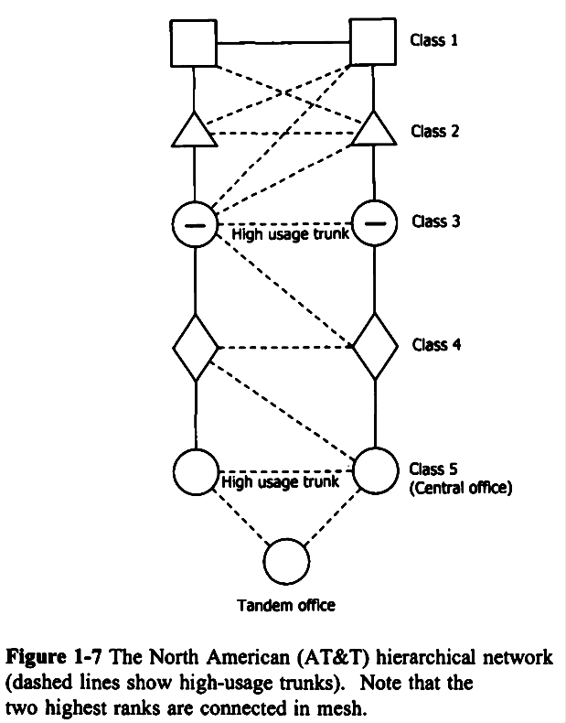
Wah Chun Chan, Performance Analysis of Telecommunications and Local Area Networks, Kluwer Academic Publishers, 2002.

Slide 8
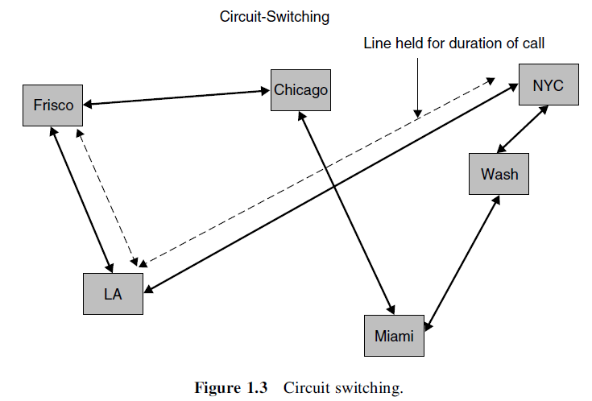
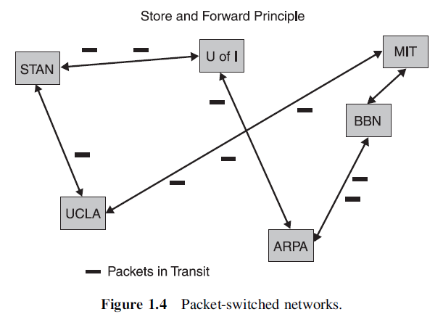
The switching types
Jeremiah F. Hayes, Thimma V. J. Ganesh Babu, Modelling and Analysis of Telecommunications Networks, John Wiley & Sons Inc, 2004

Slide 9
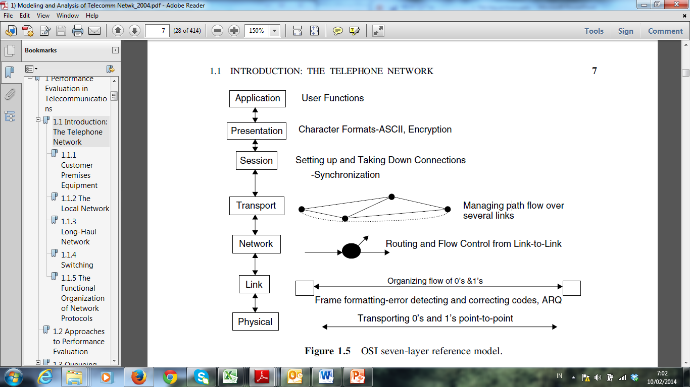
SCOPE

Slide 10
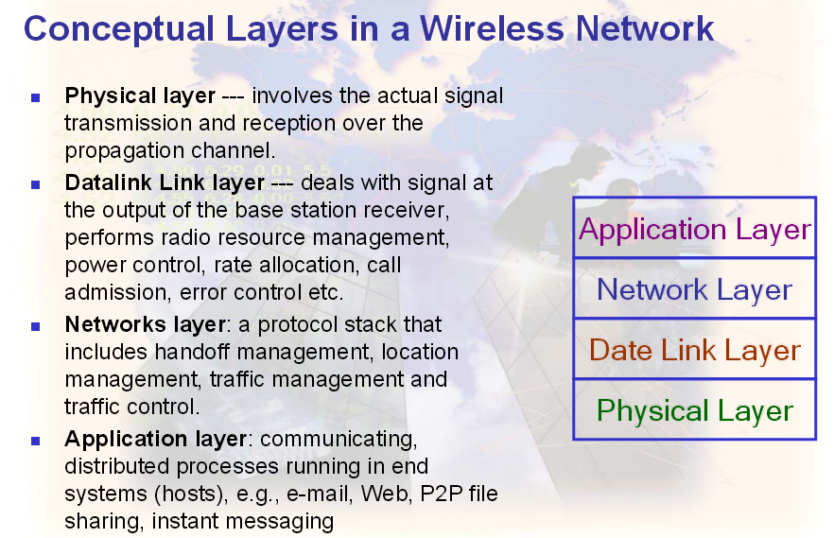

Slide 11
Current Issues
Internet is increasing exponentialy
Internet traffic and the bandwidth double in every 18 months
The bandwidth is about 100 Tbits/s
More wireless voice traffic than wired traffic
Computer Telephony Integration (CTI)
Switched telephony network to IP NGN networks (multiservices convergent networks)
Modem triple play (voice, data, TV)
Quadruple play: triple play + mobile telephony
Virtualization of the access point, green networks
IP Multimedia System (IMS) architecture: full IP arichitecture

Slide 12
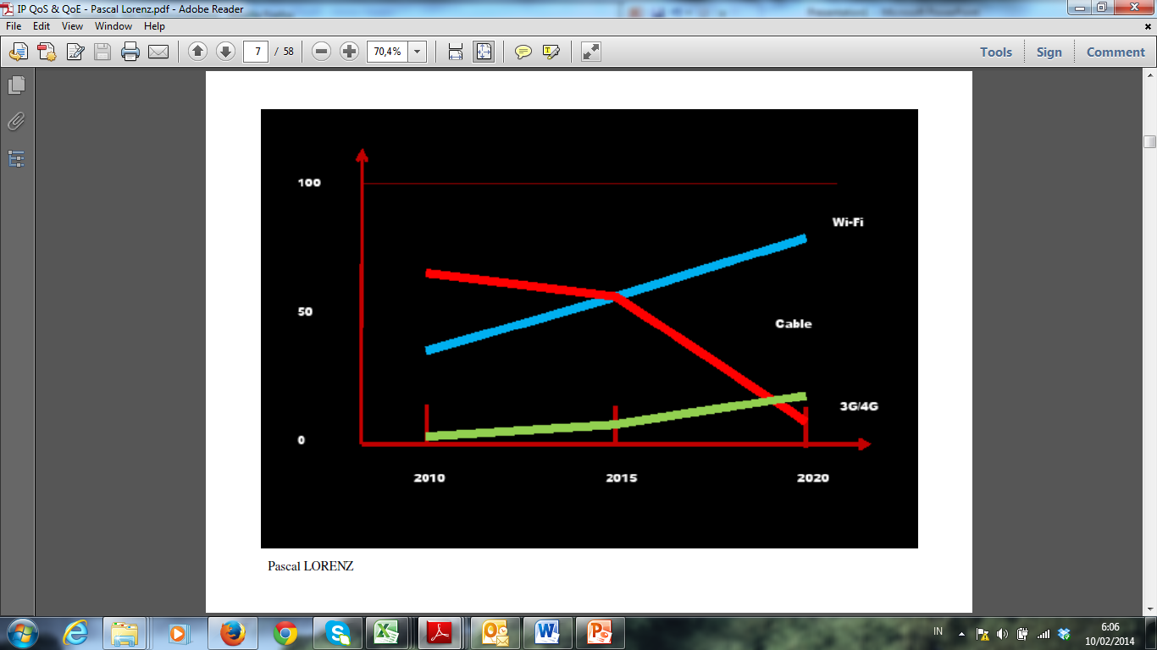

Slide 13
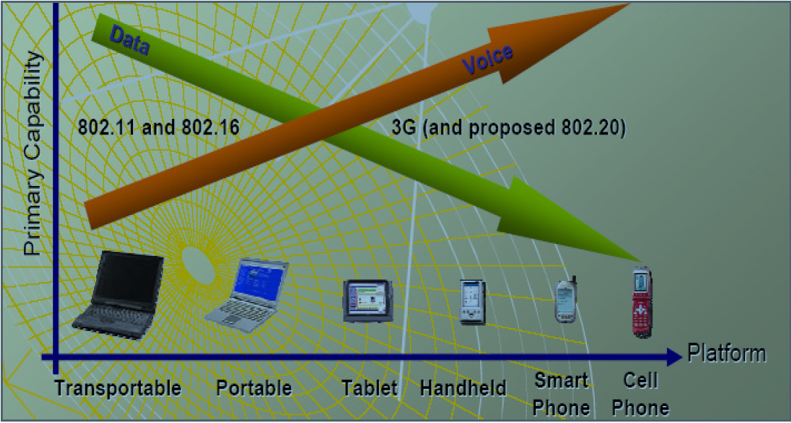

Slide 14


Slide 15
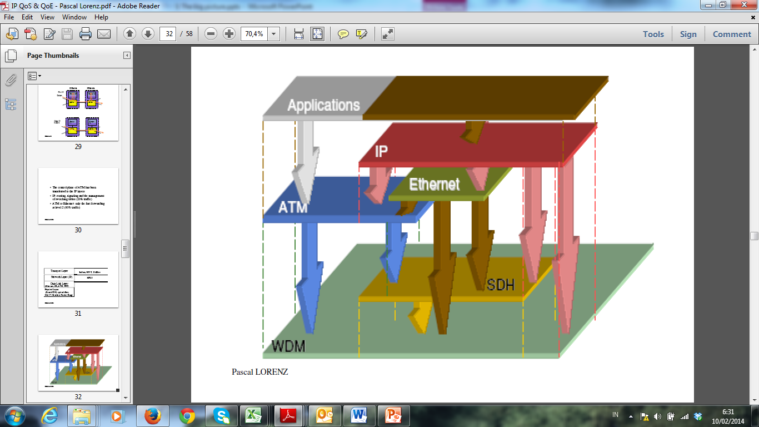

Slide 16
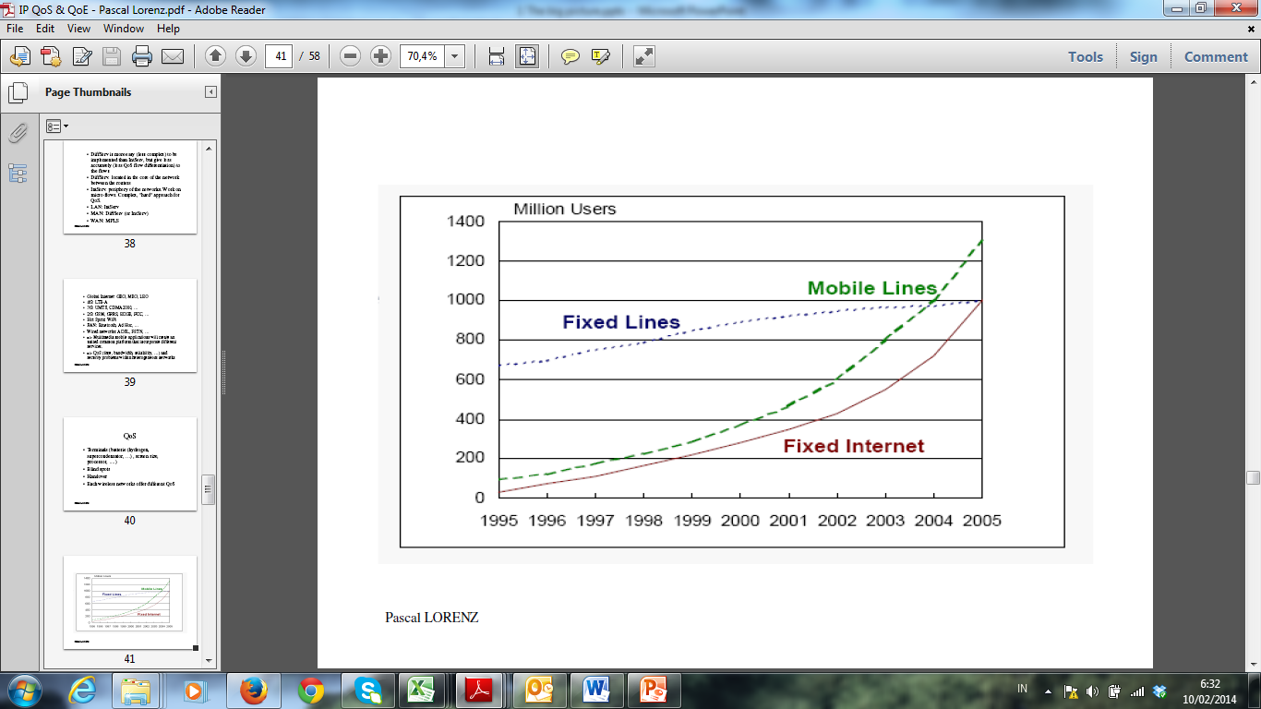

Slide 17
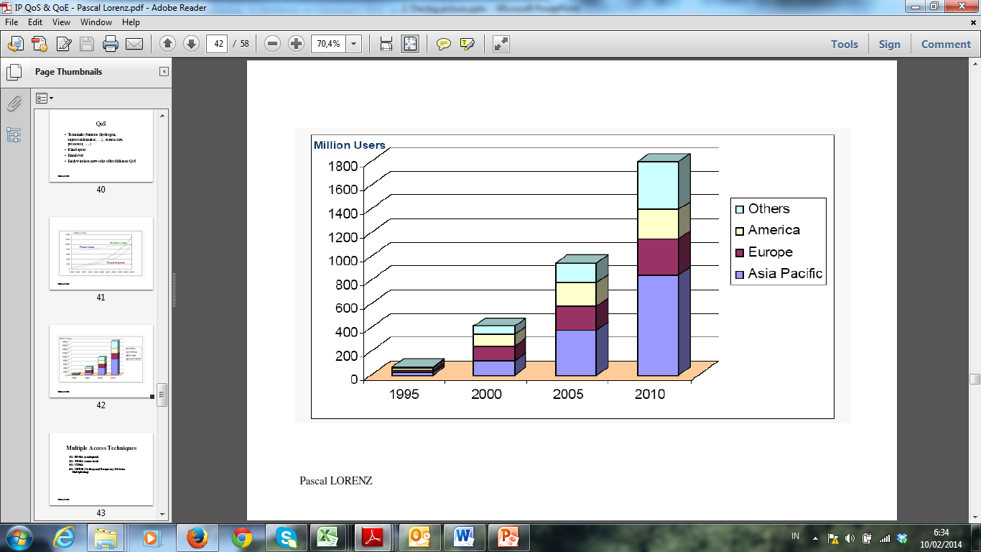

Slide 18
New communication architectures
Challenge: offer QoS in the Internet network
Multipmedia applications, VoD, IPTV for Internet will be developed and used when QoS mechanismes will exist
New functions must be developed to guarantee performance, offer security, avoid jitter, allow the respect of time-constraints,...

Slide 19
Next Generation Internet
MPLS, Native IP, Carrier Grade Ethernet
Unique network: wired and wireless, data, voice
Problem of TCP/IP: electrical consumption, complexity
Intelligence in the network: smart, active autonomic networks => autoconfiguration
Vitual Internet: Cloud and Data Center

Slide 20
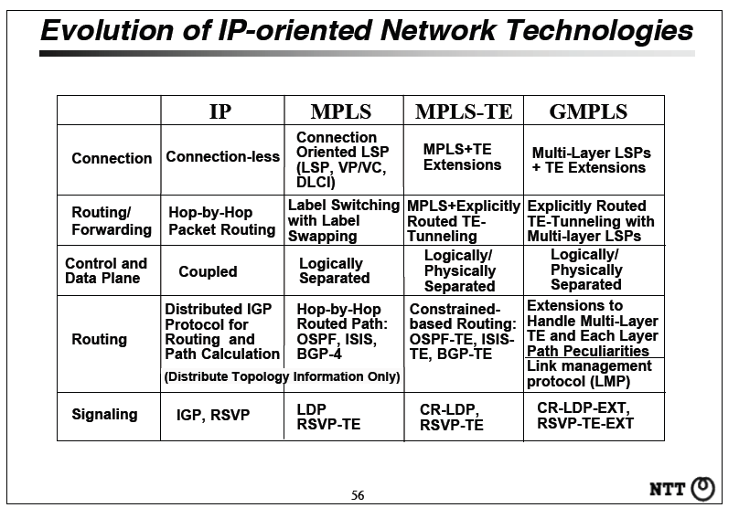
Evolution IP-oriented Network

Slide 21
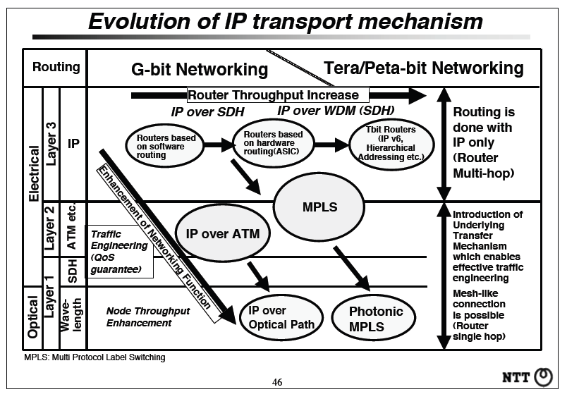
Evolution of IP transport

Slide 22
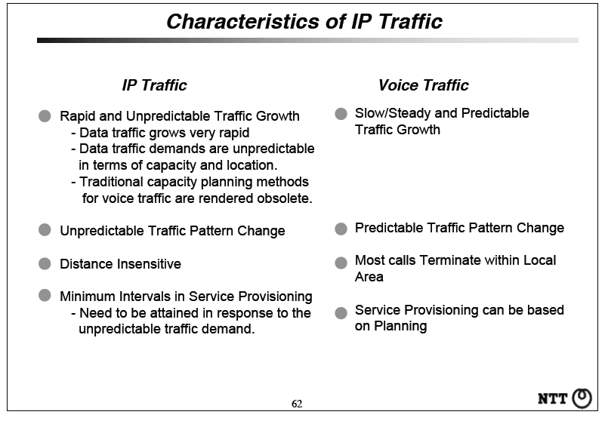
IP Traffic Characteristics

Slide 23
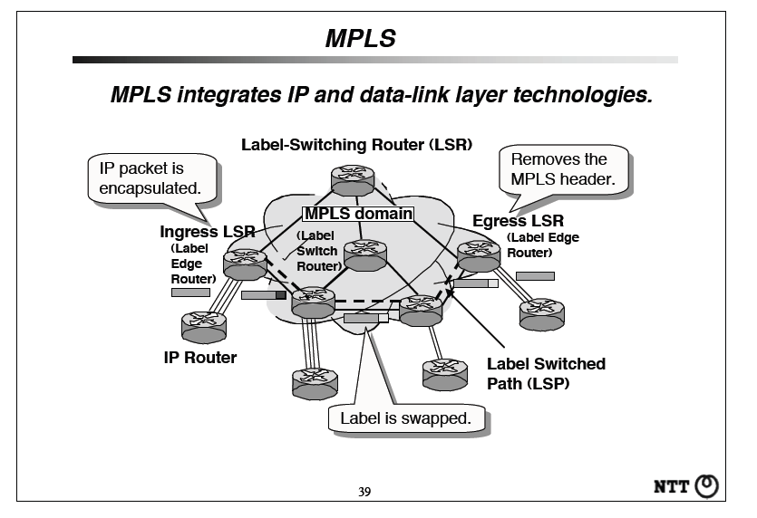
MPLS

Slide 24
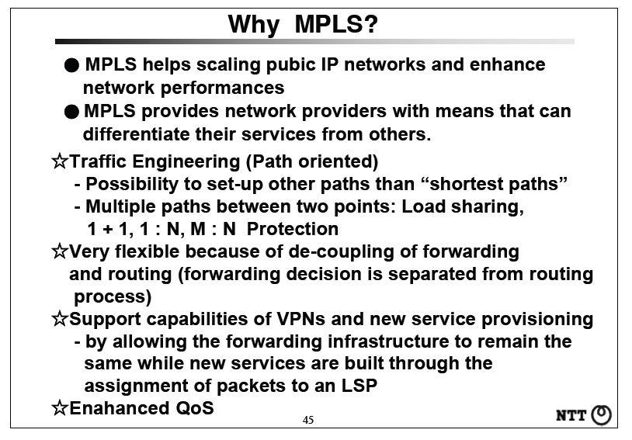
MPLS (Cont.)

Slide 25
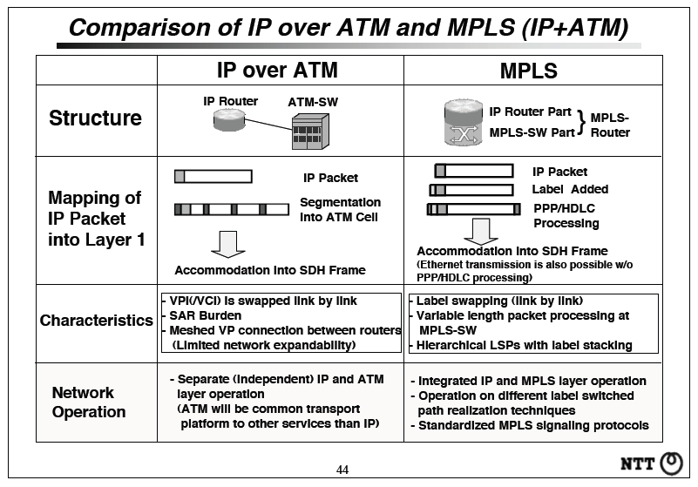
Comparison IP over ATM and MPLS

Slide 26
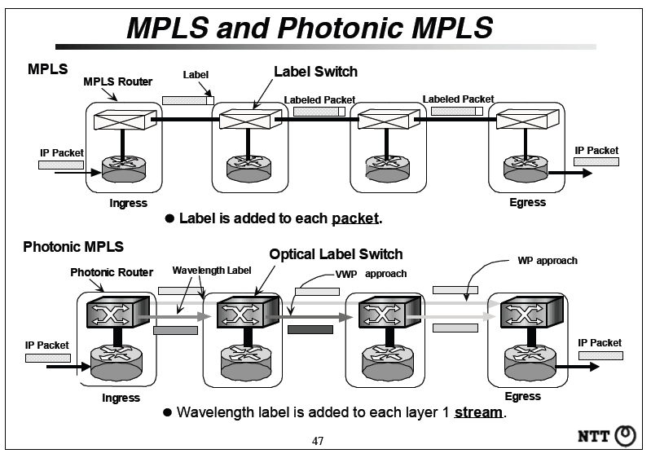
Photonic MPLS

Slide 27
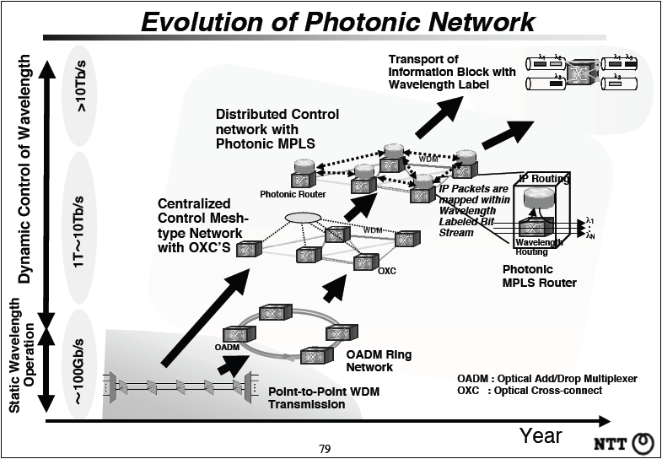
Photonic Network Architecture

Slide 28
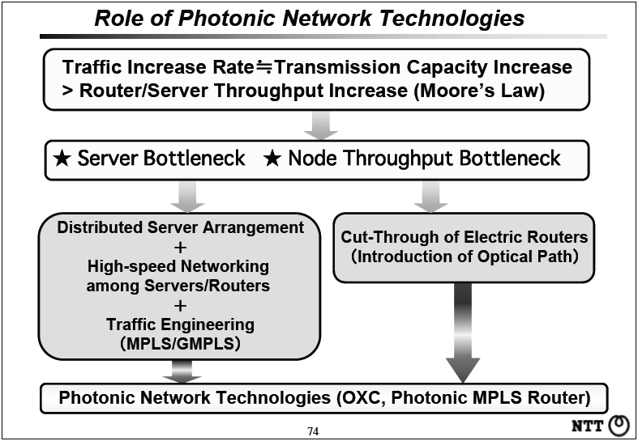
Fundamental Photonic Network

Slide 29
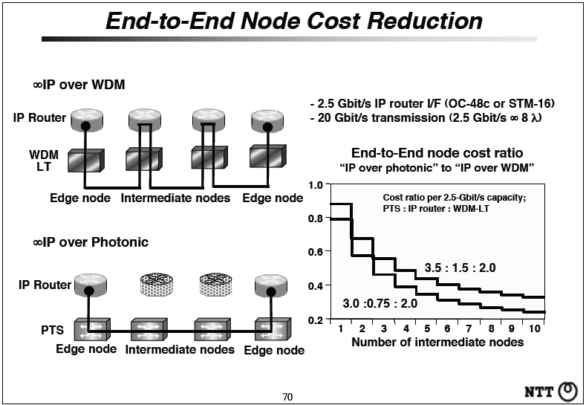
Fundamental Photonic Network (Cont.)

Slide 30
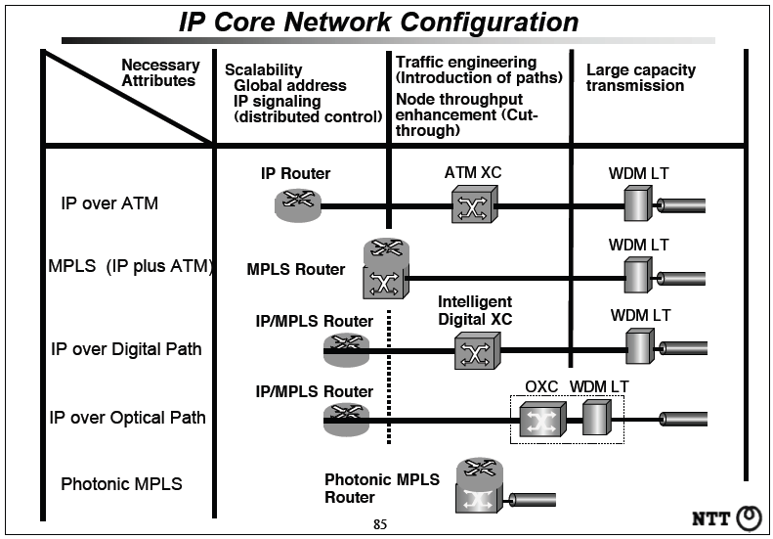
Fundamental Photonic Network (Cont.)

Slide 31
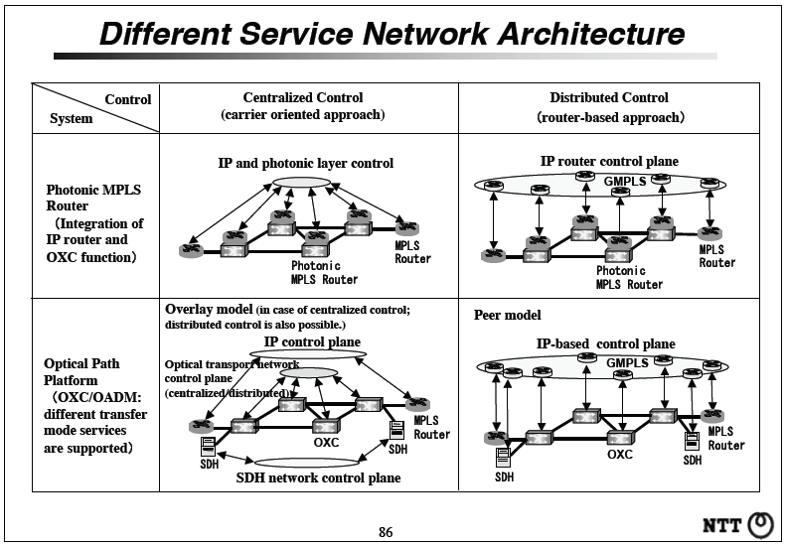
Fundamental Photonic Network (Cont.)

Slide 32
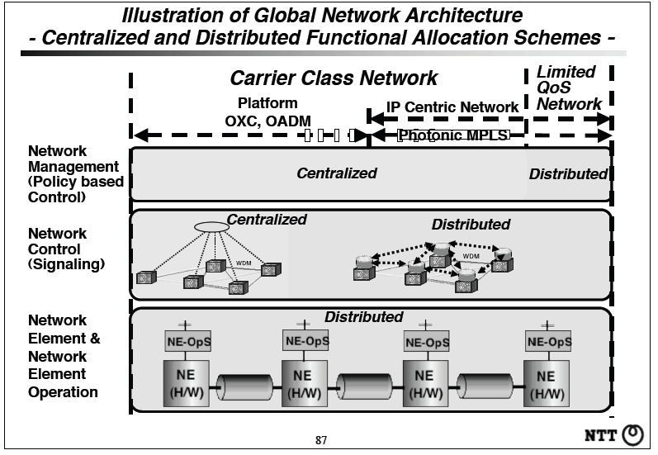
Fundamental Photonic Network (Cont.)

Slide 33
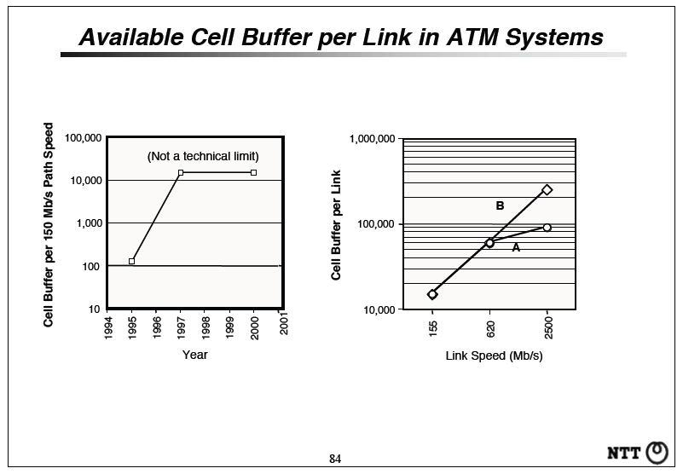
Availability cell in ATM Systems

Slide 34
Thank you

